Slide 1
HOTEL MANAGEMENT SYSTEM

Slide 2
Contents
Introduction
Methodology
Table and Relations
Conclusion

Slide 3
Introduction
The main objective of this project is to create a Database Management System for a Hotel.
This project is based on MySQL queries, triggers and pre-defined procedures.

Slide 4
ROOMS
BOOKINGS
A Hotel consists of wide areas to manage. We tried to include the main areas for a hotel management system in this project. This is just a prototype and can be developed according to the requirements of the Hotel Management and Staff
HOTEL
EMPLOYEES
GUESTS

Slide 5
methodology

Slide 6
Methodology
The hotel management system project follows a structured methodology encompassing requirements analysis, database design, implementation, testing, and deployment. It involves defining entities and relationships, designing a normalized database schema, selecting appropriate technologies, iterative development with testing, and deploying a scalable and secure system to efficiently manage hotel operations.

Slide 7
TABLES AND RELATIONS

Slide 8
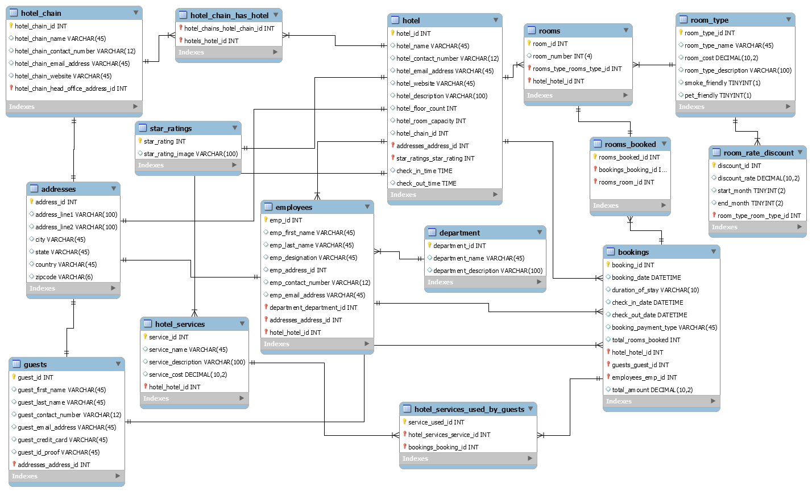
TABLES AND RELATIONS

Slide 9
CONCLUSION
In summary, implementing a Hotel Database Management System using MySQL revolutionizes hotel operations.
By automating bookings, personalizing guest services, and enabling data-driven decisions, the system optimizes resource allocation and enhances security. This modernization boosts guest satisfaction and drives revenue growth, ensuring our hotel remains competitive and successful.

Slide 10
THANK YOU
Pranav Mudigonda (AP22110010765)
Sathvik Inguva (AP22110010748)
Chaturya Lavudu (AP2211001033)
Poojitha Naga Sai Repalle (AP22110010775)
Himanish Koneru (AP22110010735)

